Slide 1
Data Handling and Creating Graphs in MS Excel
Presented By
Dr. Manjiree M. Vyawahare

Slide 2
About the MS EXCEL
MS-Excel is a Microsoft Computer Application called as a “Spreadsheet / Electronic worksheet” .
It is designed to manage, manipulate, and display data
It has functions appropriate for business and scientific data sets
Other different data management tools are available in market
But excel is best and easily useful for any one at any time ( without purchasing costly software's)

Slide 3
Basic information about Excel
Start Excel and a very first screen will appear which is nothing but a Two Dimensional Table.
The main body of the screen will contain columns and rows
Columns labeled with letters (A, B, C...)
Rows labeled with numbers (1, 2, 3...).
A cell ( intersection of Row & column) Rectangle is a space where numbers, formulas or text can be entered
Each cell has a designation (we call it as a address of the cell) that gives its location such as A10 (column A, row 10) or CC35 (column CC, row 35)
Data is stored at active cell location only…..be careful

Slide 4
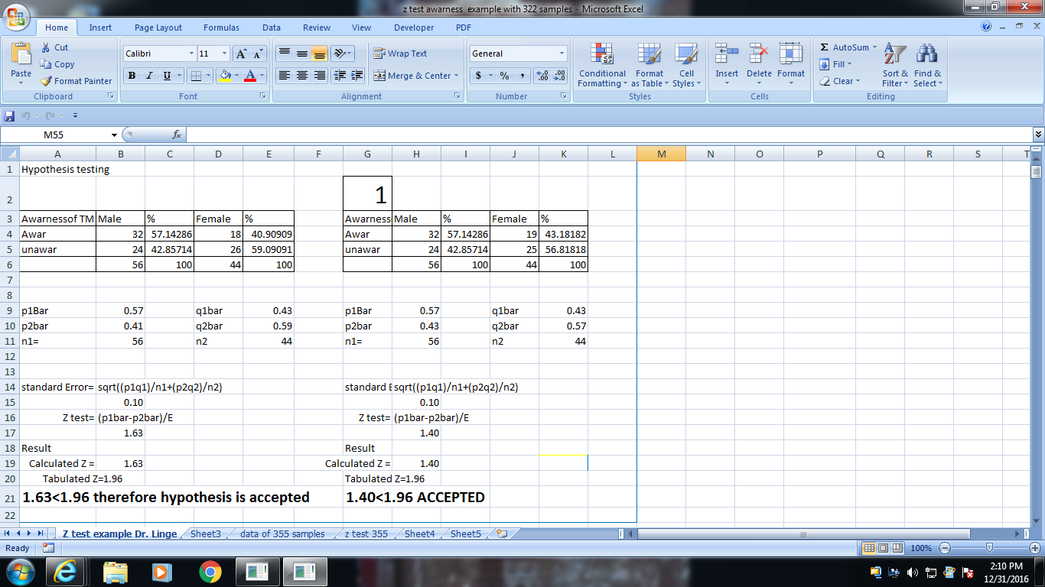
Very first screen of Excel
MENU BAR
Formula bar
Cell location

Slide 5
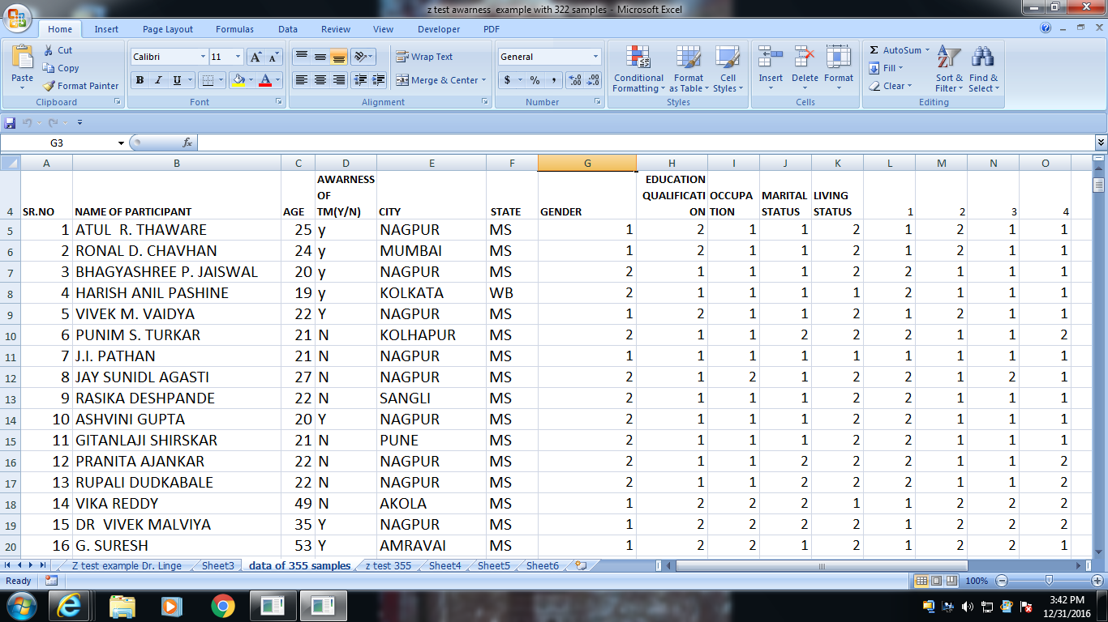
Insert data in worksheet cell by cell by assigning proper column name
Use arrow keys to shift cursor from one cell to another

Slide 6
Editing tools
After inserting data ….we need to edit it
Cell width
Cell height
Change font size, color, style, directions etc…
Fill color , alignment of text
Wrap text option is useful for word wrapping
Merge and centre is used to merge the cell
Insert and deleting row / column
Number formatting / date formatting
Data fill in series

Slide 7
Inserting simple formula in sheet
formula can be inserted using = sign
Ex. B2+C2+D2+E2+f2 [ to make sum of values from these cells]
Suppose cell H2 contains the formula =G2^3.
If you copy this formula and paste it into H3 cell, Excel will use the value in cell G3
If you want to extend a calculation for a whole series of data, just select and drag the formula.
However , if you want to lock in the cell value G2 to be used in all calculations, use absolute address
$G$2. Using the dollar signs will ensure that this cell value will not change.

Slide 8
Some simple formulas
Instead of using individual cell for addition
One can use entire range like
=Sum(b2:b30)
=min(b2:b30)
=max(b2:b30)
=average(b2:b30)
∑ symbol is used to insert sum just by clicking on symbol

Slide 9
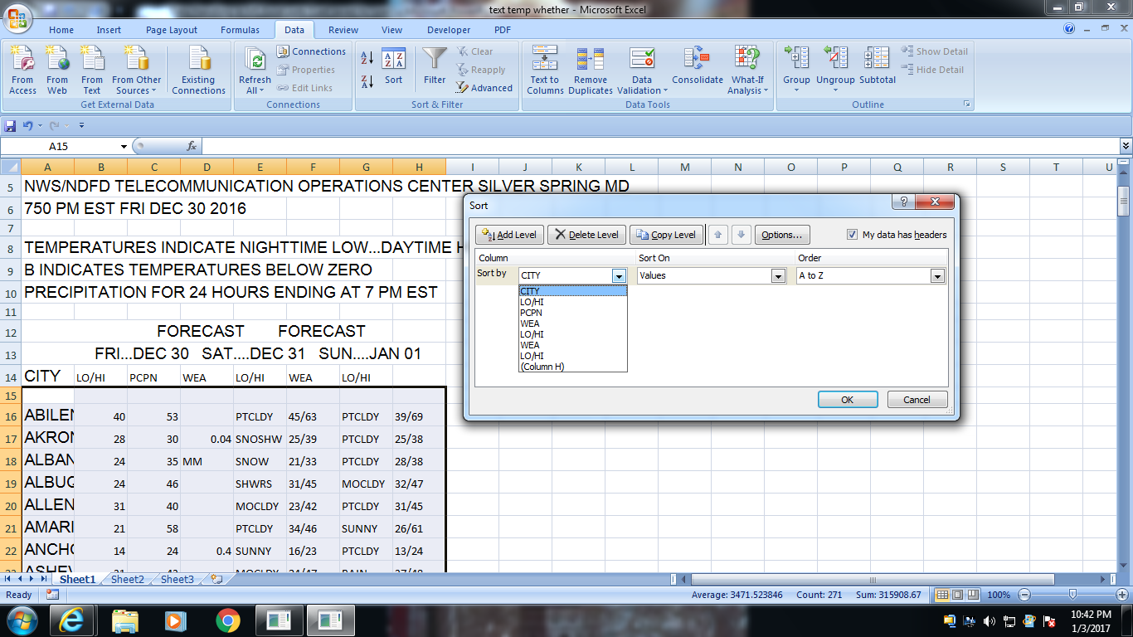
Arrange data in order
Data can be arrange in ascending / descending order as per the requirement
Data can arrange on single variable / field/column

Slide 10
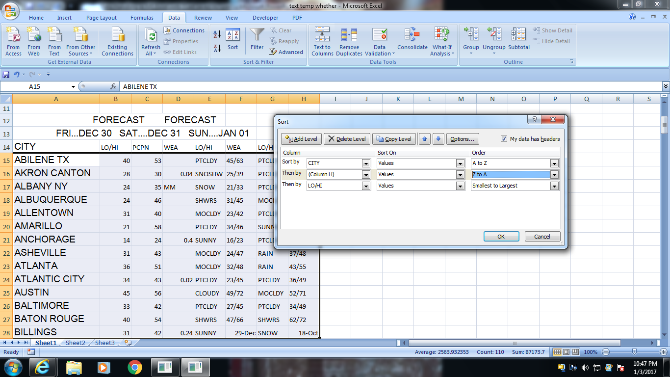
Arrange data on multiple fields

Slide 11
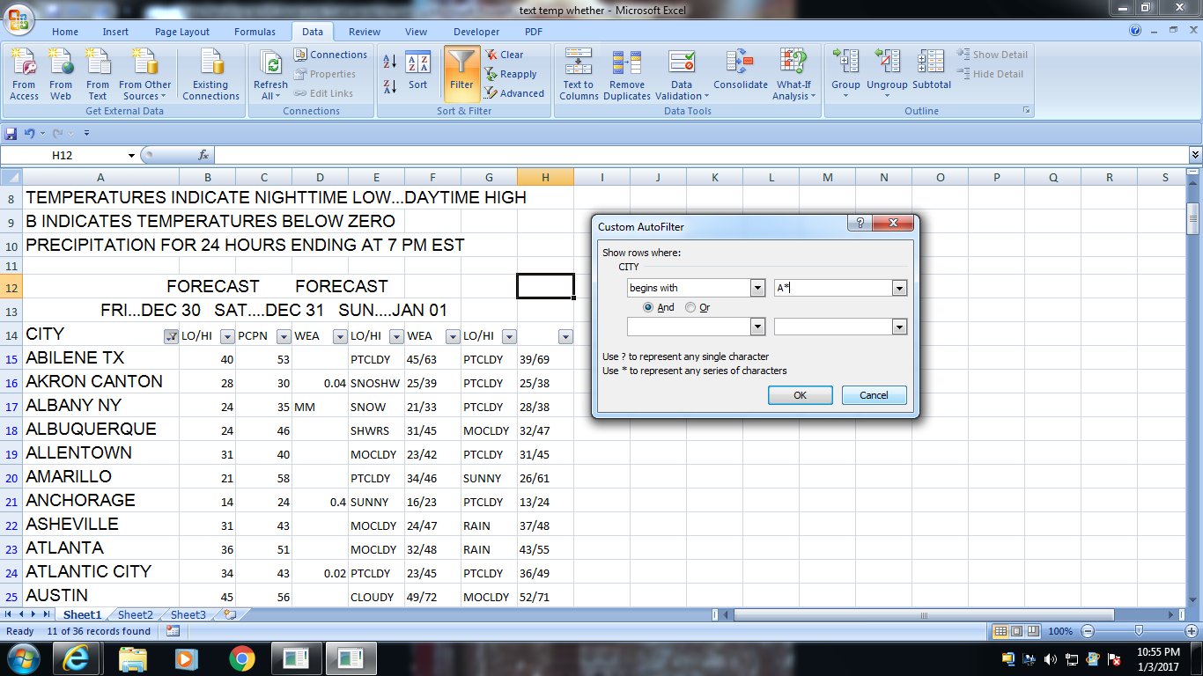
Data Filter
Filter column wise
Wild cards can be used ? * for Text filter [ eg. A* / Pra???
Number filter
Text filter on color

Slide 12
Text to column
Data imported from Internet / Reports in text format can be converted into columns
CONCORD NH 29 39 .22 SNOW 16/32 PTCLDY 29/38 CORPUS CHRISTI 52 62 CLOUDY 60/71 MOCLDY 64/78 DALLAS FT WORTH 39 60 PTCLDY 50/70 MOCLDY 43/70 DAYTON 29 35 MOCLDY 29/40 PTCLDY 27/40 DAYTONA BEACH 43 58 .06 PTCLDY 40/72 MOCLDY 56/79 DENVER 31 65 PTCLDY 20/39 PTCLDY 22/45 DES MOINES 21 48 PTCLDY 30/33 PTCLDY 21/40 DETROIT 29 32 WINDY 28/41 PTCLDY 26/38 DULUTH 10 18 .04 MOCLDY 14/18 MOCLDY 15/27 EL PASO 40 49 .06 MOCLDY 45/61 SHWRS 45/59 ELKINS 27 30 .08 MOCLDY 17/45 MOCLDY 34/47 ERIE 31 32 .02 SHWRS 27/40 PTCLDY 30/37 EUGENE 36 47 .06 PTCLDY 28/38 SHWRS 35/36 EVANSVILLE 33 44 RAIN 35/44 MOCLDY 33/47 FAIRBANKS 07 30 .90 SNOW 22/28 PTCLDY 12/17 FARGO 12 28 MOCLDY 12/22 MOCLDY 13/22 FLAGSTAFF 15 45 SNOSHW 31/37 SNOSHW 27/36
Cont…..

Slide 13
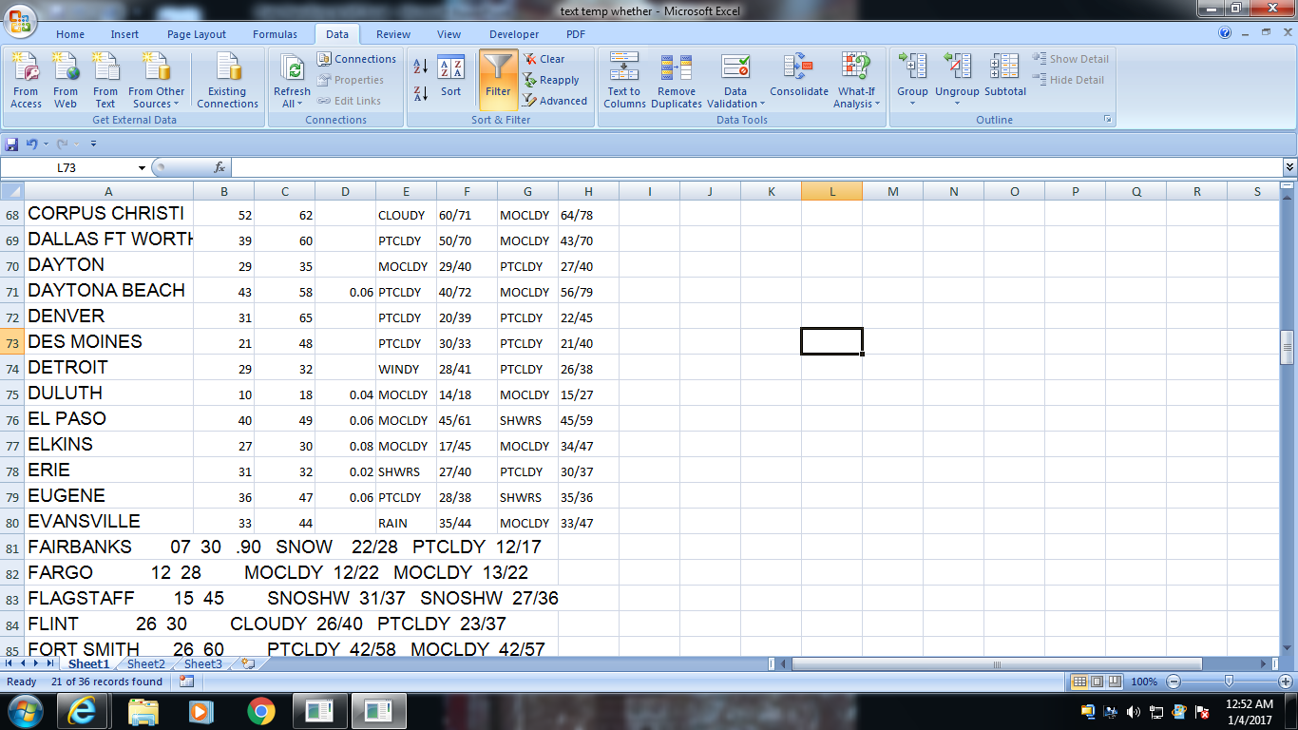
Text to column

Slide 14
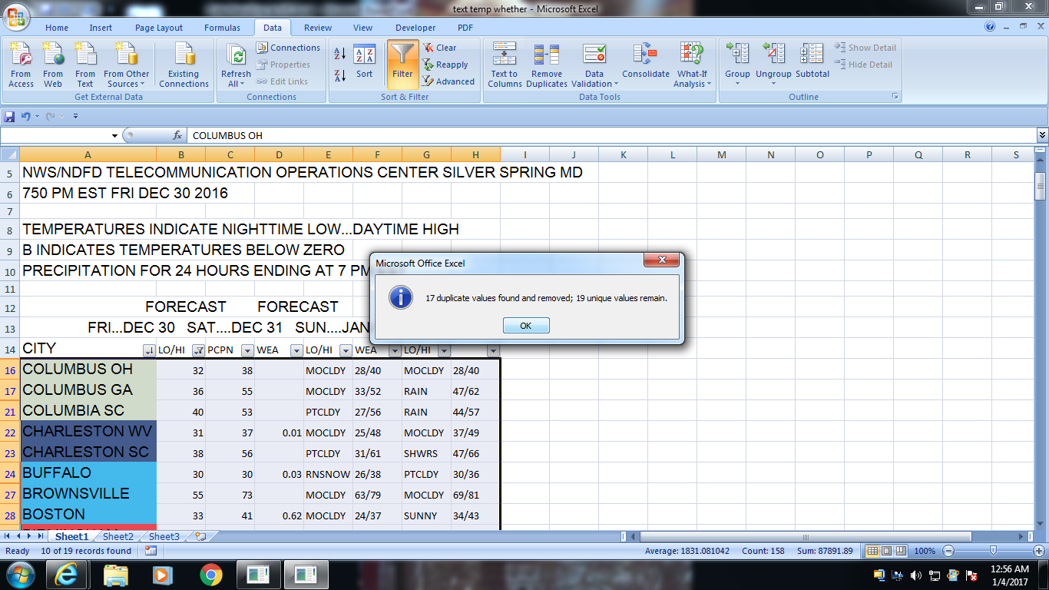
Removes duplicate

Slide 15
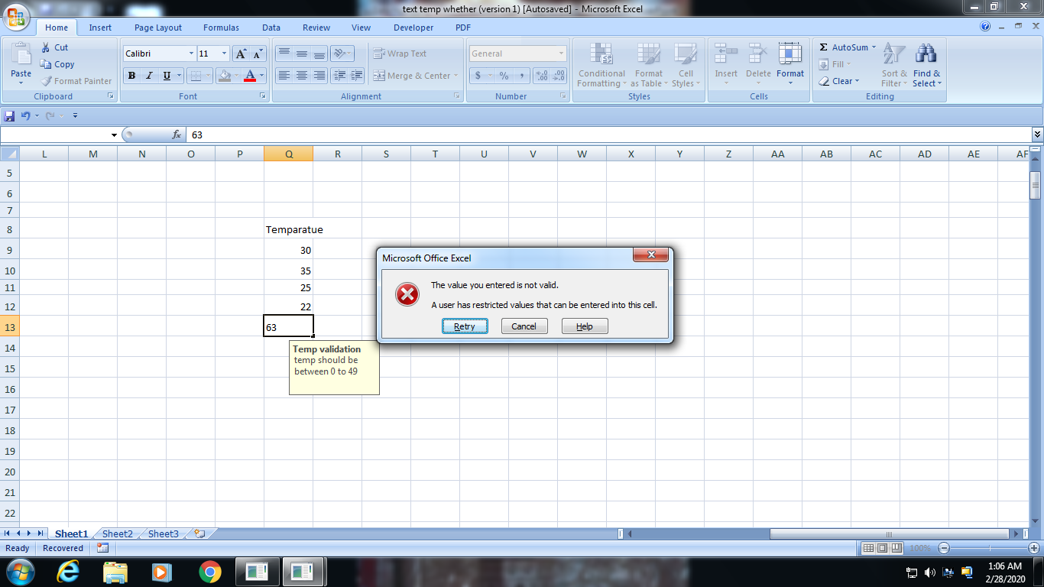
Data Validation
Prevent Invalid data entering into the cell

Slide 16
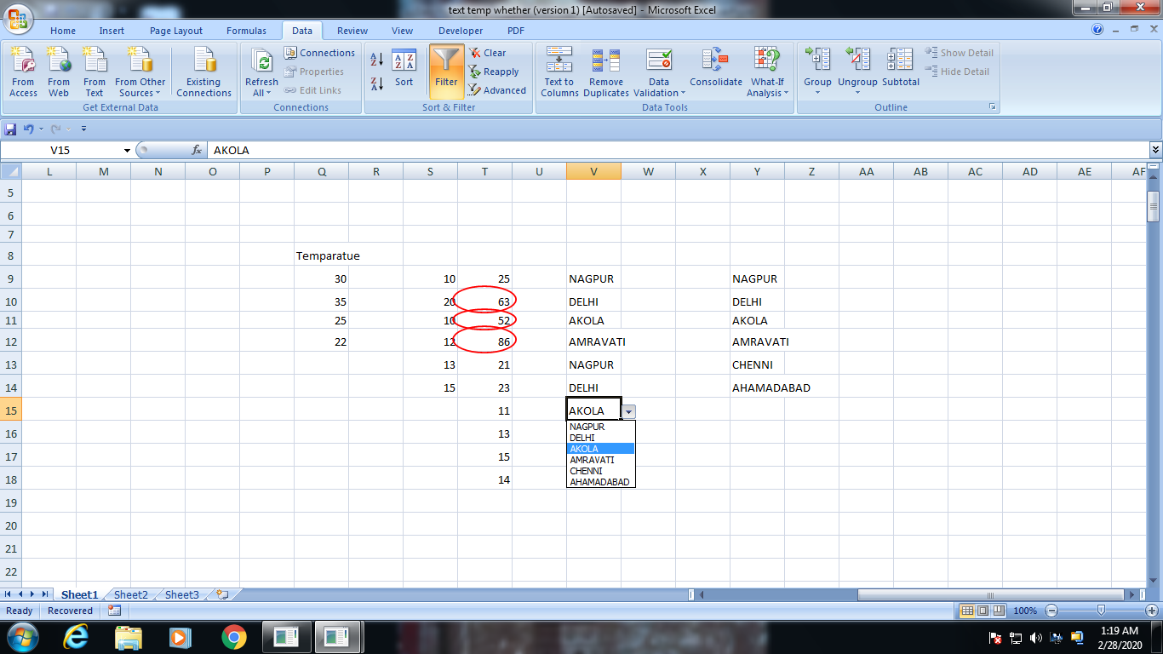
DATA VALIDATION
VALID DATA ENTRY :
Circle invalid data
Force to insert listed data

Slide 17
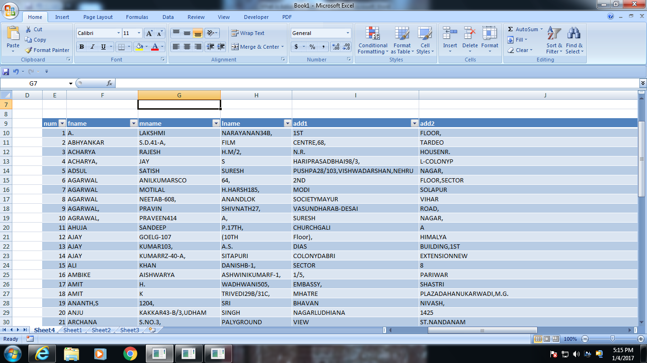
Data from access

Slide 18
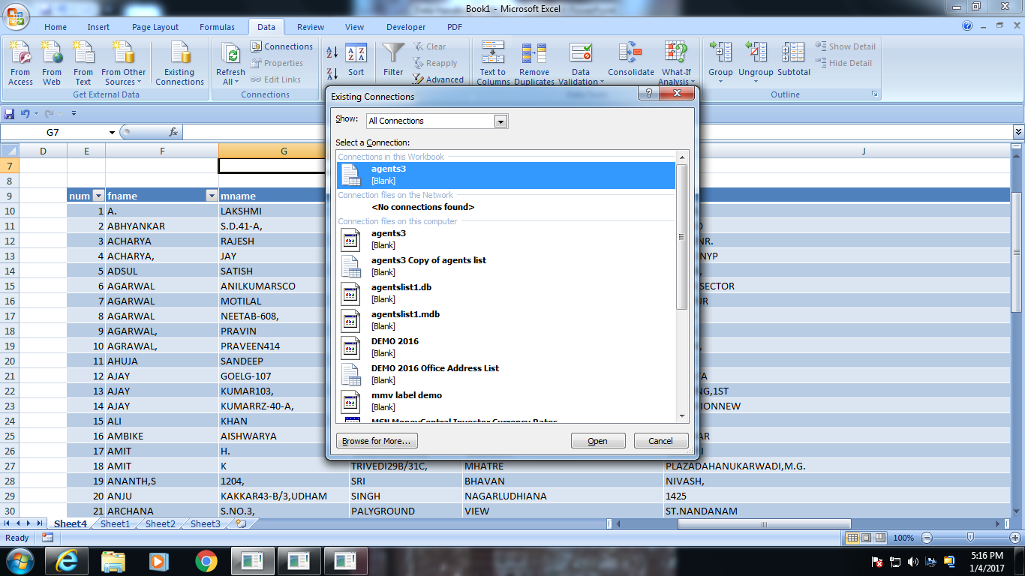
Data from existing connections

Slide 19
Graph
Graphs are also called as a charts..
Graphs are incredibly useful tools in Excel
It is very easy to add them to your spreadsheets
Graphs are helpful to tell a visual presentation of data
Therefore, it is important to learn how to make graphs

Slide 20
Building a chart in Excel
Is not a difficult task……
Set you mind for…which types of chart to use in which situation
Excel has 11 major chart types with sub types in each type
Excel, including the following types of charts
Line charts
Bar charts
Pie charts
Etc…….

Slide 21
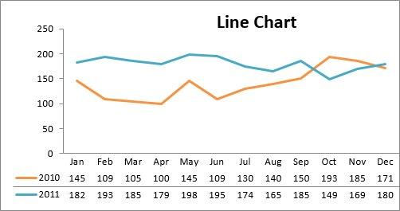
Line Chart
The line chart is one of the most frequently used chart types, typically used to show trends over a period of time.
If you need to chart changes over time, consider using a line chart.

Slide 22
Column Chart:
Column charts are typically used to compare several items in a specific range of values.
Column charts are ideal if you need to compare a single category of data between individual sub-items, such as, for example, when comparing revenue between regions.

Slide 23
Clustered Column Chart:
A clustered column chart can be used if you need to compare multiple categories of data within individual sub-items as well as between sub-items. For instance, you can use a clustered column chart to compare revenue for each year within each region, as well as between regions.

Slide 24
Stacked Column Chart
A stacked column chart allows you to compare items in a specific range of values as well as show the relationship of the individual sub-items with the whole. For instance, a stacked column chart can show not only the overall revenue for each year, but also the proportion of the total revenue made up by each region.

Slide 25
Pie Chart
Another frequently used chart is the old pie chart. A pie chart represents the distribution or proportion of each data item over a total value (represented by the overall pie).

Slide 26
Bar Chart
Bar charts are typically used to compare several categories of data. Bar charts are ideal for visualizing the distribution or proportion of data items when there are more than three categories. For instance a bar chart could be used to compare the overall revenue distribution for a given set of products

Slide 27
Area Chart
Area charts are ideal for clearly illustrating the magnitude of change between two or more data points. For example, you can give your audience a visual feel for the degree of variance between the high and low price for each month.

Slide 28
XY Scatter Plot Chart
Scatter charts in Excel (also known as XY scatter plot charts) are excellent for showing correlations between two sets of values.
For example an XY scatter plot can be used to illustrate the correlation between employee performance and competency, demonstrating that employee performance rises as competency improves. The x and y axes work together to represent data plots on the chart based on the intersection of x values and y values.

Slide 29
Bubble Chart
A bubble chart is a variation of an XY scatter plot. Just like the XY scatter plot, bubble charts show the correlation between two sets of data.

Slide 30
Creating Graph in Excel
Enter your data into the Excel spreadsheet in table format.
Your data should have column headers, row headers.
In Excel, "columns" refer to vertical depth.
The columns are labeled with letters, "A," "B," "C," etc.
"Rows," on the other hand, refer to horizontal distance. They are labeled with numbers, "1," "2," "3," etc.

Slide 31
With your cursor, highlight the cells that contain the information that you want to appear in your graph.
If you want the column labels and the row labels to show up in the graph, ensure that those are selected also.
click Insert → Chart
you can also try navigating to the Charts tab in the Ribbon tab and selecting the specific kind of graph you'd like to use.
This will create your a graph on a “chart sheet.”
A chart sheet is basically a spreadsheet page within a workbook that is totally dedicated to displaying your graph.
For Windows users, you can create a graph with a shortcut by hitting the F11 button on your keyboard.

Slide 32
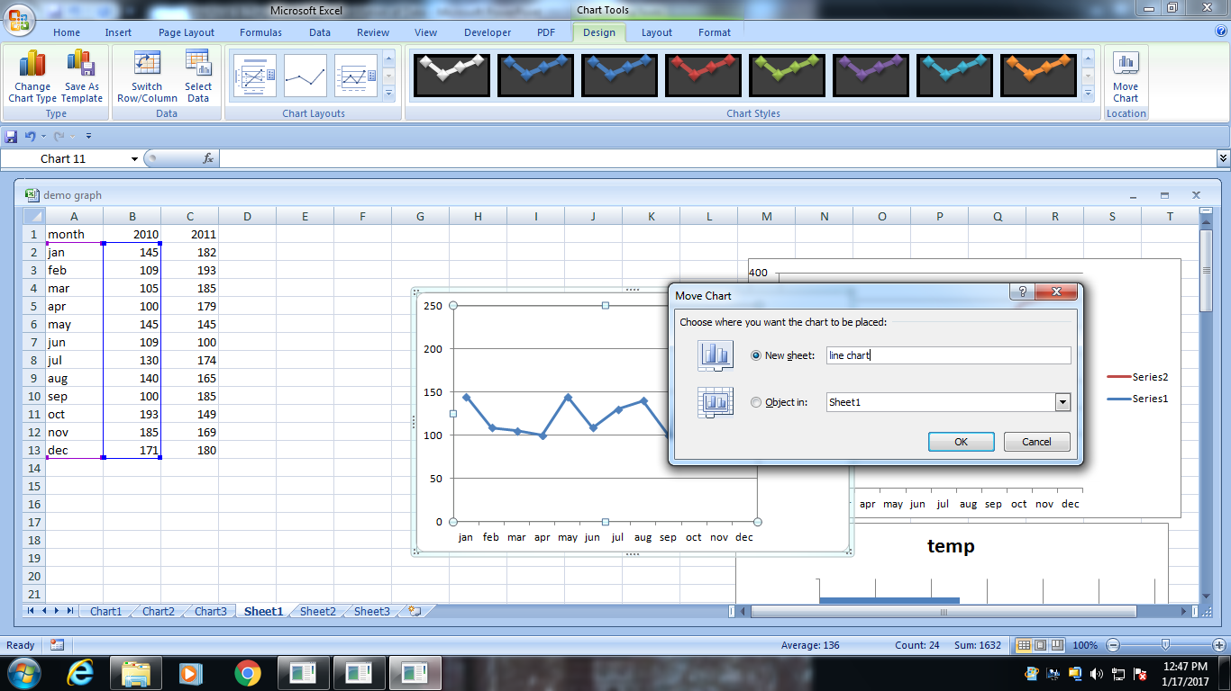
Save your chart at different location
By default chart is stored on same worksheet
You can store chart at different location
Just by clicking move chart tab

Slide 33
Thanks
Any Questions?

